Slide 1
Comms – Direct
Capgemini’s Telco Rapid Cloud Solution on Oracle

Slide 2
What we hear from the Telco customers......
We need to simplify our Business
We are not able to respond to the market needs with our existing IT Platform
We don’t have a Capital Budget to run big transformation programs
We need reduced and predictable operating costs
We don’t have the skills in-house
We need to act now and show results in months rather than years
We need to improve customer experience
We need to transform the business, but we don’t “know how”

Slide 3
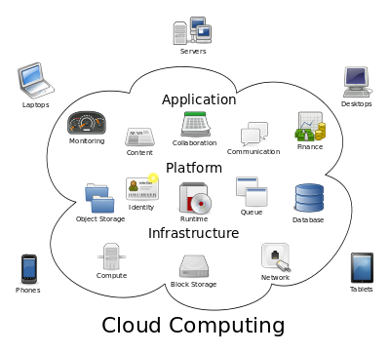
What is Cloud Computing? What is RODOD?
Cloud computing allows application software to be operated using internet-enabled devices. Cloud computing relies on sharing of resources to achieve coherence and economies of scale, similar to a utility (like the electricity grid) over a network. At the foundation of cloud computing is the broader concept of converged infrastructure and shared services..
RODOD- Rapid Offer Design and Order Delivery
Application: RODOD as a product-based and pre-integrated solution allows you to accelerate design and delivery of products, services, and bundles across multiple channels rapidly and accurately to improve customer satisfaction.
It is a Business Suite of applications primarily based on Siebel CRM, OSM, BRM & AIA

Slide 4
Key Drivers
Offer a light weight & low cost alternative E2E solution to the Oracle RODOD Framework for Tier 3 & Tier 4 Telecom service providers targeted towards next gen subscription based services like Broadband, VOIP, IP TV, Mobile Services etc.
Increase sales force adoption with a simple, easy-to-use UI tailored to Sales Reps and Sales Executives & multi channel experience over cloud platform
Complete customer lifecycle management including Concept to Cash and Unified Customer and Billing Care
Offer rich & robust functionality around Analytics, Mobility & Security
Why Cloud for Telco
The cloud based RODOD - Lite solution will be up running instantly allowing “Look and Feel” early in the journey towards simplified and standardized business operations
Traditional cloud benefits such as minimized upfront investment, reduced TCO, Pay as you go, continuous functional upgrades as the solution evolves
Minimized Risk: Early success or fast failure
Tbaytel (Canada) & AT&T potential clients in this regard with whom we are collaborating

Slide 5



Ways to Modernize Customer Experience
Modernize
Standardize
Transform
Traditional Marketing to Digital Marketing
Assisted Service to Empowered Customers
Unresponsiveness to Social Engagement
Disjointed to Agile, Collaborative & Insight-Driven Selling
Standardization of sales performance and optimization processes
Standardization of customer care processes
Transformation of Concept to Cash processes
Complete CX with Digital Modernization and Process Standardization

Slide 6
Order to Cash - New Sales Order (Current Scope)
Sales
Sales Cloud
Identify Account Hierarchy
Create Service Address under Account
Create Opportunity
Account Sync Service
Create Customer Assets
A
CPQ
Create Quote
Finalize Quote & Generate Order
Submit Order
Update Order
CPQ Cloud
Configuration, Costing & Pricing
Cross & Up Sell
Order
Lifecycle
Mgmt
Orchestrate Order
OFM/ESB
Transform / Enrich Order
Decompose Order, Route Order Components & Listen to Responses and Updates
Order Status Management
Sync Customer
Initiate Billing
Update Order &
Status
Billing
BRM
Debt Checks & Updates
Sync Account Hierarchy
Invoice & Payments
A
Downstream
Systems
Order Provisioning

Slide 7

Concept to Cash to Care (Overall Roadmap)
Customer
Interaction
Call Center
Self Care
Mobile
Partner
Social
Channel Coordination
Marketing
Sales
CPQ
Service
OTBI-E
Product Master Data Management
Customer Master Data Management
Order Orchestration
Order and
Revenue Management
Downstream Systems
Rate – Bill – Charge – Policy
Order decomposition & Provisioning
Platform as a Service
Infrastructure as a Service

Slide 8
Deep Functional Integrations
Social Cloud to
Marketing Cloud to
Marketing Cloud
Sales Cloud
Service Cloud
.
.
.
Sales Cloud
Social Cloud
Integrated
Service Cloud to
Sales Cloud to
Sales Cloud
Social Cloud
OSN
.
.
.
Marketing Cloud
CPQ Cloud
Service Cloud
Social Cloud
OSN
BRM
CPQ Cloud to
Sales Cloud
BRM
In Current Scope
.
.
Future Roadmap

Slide 9
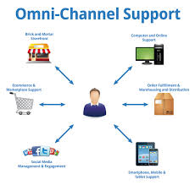


Solution Architecture (RODOD - Lite for Telco)
Customer Relationship Management
CRM
Sales Cloud
Customer Mgmt
Products (Basic Setup)
Sales (Oppty, Leads)
Assets
ESB
Customer Relationship Management
Incident Mgmt
Service Cloud
Order Decomposition
Customer Relationship Management
Customer Sync
BRM
OTBI -E
Knowledge Base
Customer Center
Billing
Products
Transactional Reporting
Billing Order Provisioning
Invoicing
Revenue Follow up
Customer Relationship Management
Order Mgmt
CPQ
Quote\Order Entry
Asset Creation
Order Orchestration
Order Provisioning Systems
Quote Mgmt
Products
Order Submit
Technical Order Provisioning
Pricing
Order Mgmt
Order Completion

Slide 10
Solution Scope & Approach
Current Scope
Phase I
Account, Leads & Opportunity Management for desktop & mobiles
Customer sync between Sales Cloud & BRM
Reporting & Mobile Analytics for Sales Cloud
Phase 2
Basic Asset Mgmt in Sales Cloud & basic integration with Service & CPQ Cloud
Products, Pricing & Quotes in CPQ Cloud & Incident Mgmt in Service Cloud
Sales Planning & Performance Management
Partner Portal in Sales Cloud
Phase 3
Order Fulfillment & Provisioning for New Sales Order
Integrated feature to create incidents in Sales Cloud & Opportunities in Service Cloud
CTI integration with Service Cloud leverage Capgemini’s Odigo offering
Social integration with Service Cloud
Future Roadmap
Introduce Marketing Cloud in the CX Cloud solution (Integrate with Sales Cloud)
Integration of Oracle CX Cloud with OTBI-E
Customer Portal & Knowledge Base for Self Care using Service Cloud
Complex order management functionality - modify, suspend, resume & disconnect orders
MDM requirements around Customer & Products Data Management

Slide 11
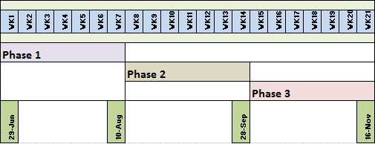
Timelines & Benefits to Capgemini
There will be a Phase Zero for 3 weeks focusing on procuring of environments, licenses & resources as well as elaboration of the high level requirements.
Basic Integration between Sales, Service & CPQ Clouds available after Phase 2 (end of Q3 2015)
Phase 3 will focus on order fulfillment & provisioning along with some CX components
This implementation will help to add significant value to our CRM Advantage offering as well as help build our capability since our team has not worked on couple of these cloud products and their integration with Sales Cloud

Slide 12
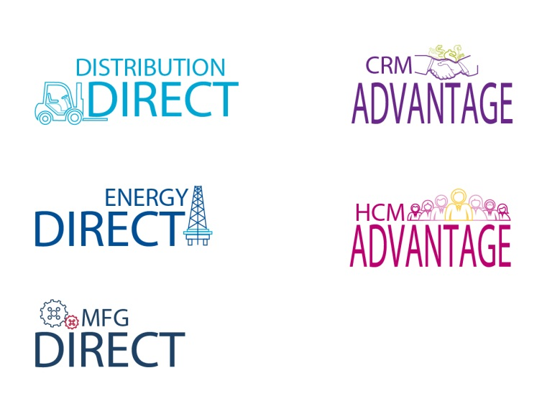
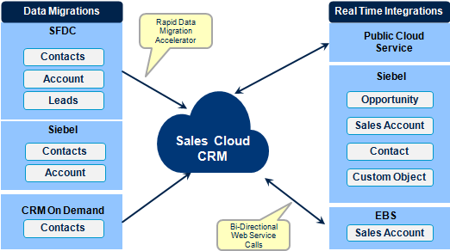
Leverage & Enrich CRM Advantage
SFA solns around Sales Planning, Sales Mgmt etc. as well as data integration & framework accelerators already built for CRM Advantage solutions will be leveraged for the Comms – Direct soln.
Solution components built out in Comms-Direct will be leveraged to expand CRM Advantage solution offering (e.g. CX Cloud integrations, SOA based integrations across the CX Cloud stack etc.)
Use Case based SFA Solutions
Data Integration Accelerators
Oracle Sales Cloud
Sales Planning
Sales Predictor
Forecast Management
Territory Management
Partner Management
Incentive Compensation
Quota Management
Sales Management
Lead Management
Opportunity
Management
Sales Campaigns
Mobile Sales
Reporting & Analytics
Desktop (MS Outlook) Integration
Data Migration Accelerators
Real Time Integrations
Error Handling Framework
Workload Based Assignments
Not available
OOTB
Configured OOTB modules to form E2E Solution Flow

Slide 13
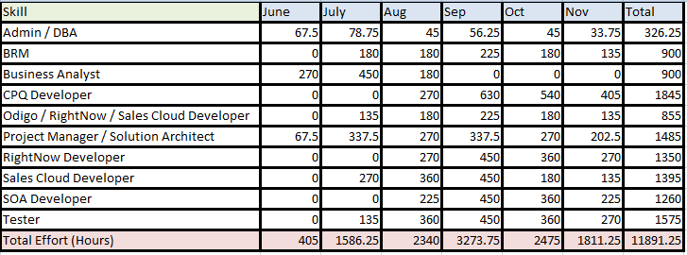
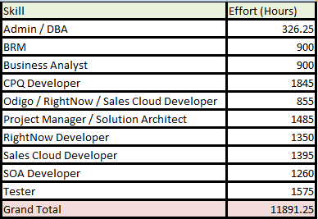
Proposed Staffing & Budget
Total Effort - 11,892 hours
Budgeted Cost - $102,420
Note – The above cost is only for staffing requirements. It does not include other costs like Environment, licenses etc.

Slide 14
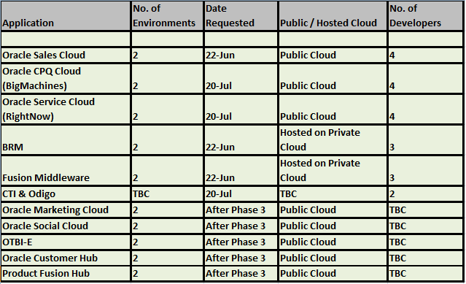
Risks & Dependencies
Risks
Delay in procuring the specific environments based on planned dates may impact timelines.
Delay in procuring the skilled resources based on planned dates may impact timelines.
Lack of past experience in areas like CPQ & Service Cloud
Lack of past experience in integrating CX Cloud applications as well as their integration with OBIEE
Any unanticipated & unresolved blocking issues or product limitations from Oracle may requiring replanning the scope & timelines.
Staffing of niche skills like RightNow, CPQ Cloud (BigMachines) & BRM by planned dates.
Not much visibility on Oracle’s solution for Comms industry. May lead so some future realignment.
Dependencies
Environment Dependencies
Availability of dedicated
resources based on planned
dates as per proposed timelines

Slide 15
Telco Rapid Cloud Solution– In summary
Pre-configured Business Solution - based on best practice Business processes and Product Models
Pre-integrated IT Solution - defined across multiple Oracle modules (Sales, Service, CPQ Marketing & Social Clouds, BRM & Fusion Middleware )
Private & Public Cloud - Infrastructure provided as a Service and instantly available (Public Cloud for CX Apps & Private Cloud for BRM & Fusion Middleware)
Rapid deployment - Reduced time to Go-Live
Lower upfront investment - Infrastructure and core IT services being offered on a subscription basis
Reduced TCO - based on virtualization of platform and cross utilization of resources
Best in Class “future proof” solution - alignment with upcoming product releases secured
”A disruptive approach shifting the focus from Technology Solutions to Business Services.”

